Slide 1

32555 – Fundamentals of Software Development

Slide 2
Welcome to 32555 – Fundamentals of Software Development
Your Teaching Team:
Dr. Yining Hu | Subject Coordinator
Yining is a Lecturer in Software Engineering. She works with many SMEs to develop software and AI solutions through student and research projects at UTS.
Contact: yining.hu@uts.edu.au
Dr. Xiaojie (Zoe) Lin | Tutor
Zoe is a full-stack software engineer with an interest in data analysis, specializing in JAVA, R, Python, JavaScript, PHP, Bash, and MATLAB; familiar with AWS.
Contact: Xiaojie.Lin@uts.edu.au
Dr. Farshid Keivanian | Tutor
Dr. Farshid Keivanian is an experienced university lecturer and researcher with a PhD in Information Technology. He has over 15 years of teaching experience across Australian institutions, specialising in software engineering, data science, AI, and cybersecurity.
Contact: Farshid.Keivanian@uts.edu.au
Yong Pov | Tutor
Yong is a full-stack software engineer with experience in React, JavaScript, TypeScript, Java, Python, SQL, and AI-assisted learning platforms.
Contact: Yong.Pov@uts.edu.au

Slide 3
Welcome to 32555 – Fundamentals of Software Development
Cmp1 # | Location | Time | Tutor
01 | CB11.B1.400 | Fri 16:00-18:00 | Xiaojie (Zoe) Lin
07 | CB11.B1.401 | Wed 10:00-12:00 | Farshid Keivanian
08 | CB11.B1.400 | Fri 12:00-14:00 | Yong Pov
09 | CB11.B1.103 | Wed 16:00-18:00 | Farshid Keivanian
10 | CB11.B1.401 | Wed 12:00-14:00 | Farshid Keivanian

Slide 4
Week 6 Outline
Assessment 1 Part 1 – Final Clarifications and Quality Check
Have you formed your group?
Lab 6 Exercises
Example & Activity — Campus Parking Permit System
Group Assignment – Part 1: What to do / submit / avoid
Group Assignment – Part 1: Student Operations After Registration – Clarified
Group Assignment – Part 1: Password Rules – Clarified
Mini Coding Nudges (Email/Password, Marks, Pass/Fail etc.)
Allow student. subdomain too
Allow optional - or _ before digits in password
Generate Random Marks and Assign Grades
Make randomness reproducible
Add student ID and PASS/FAIL
Grade Classification Based on University Rules
Group Assignment – Part 2: Build hints (Python-first, JavaFX minority)
Group Assignment – Part 3: Showcase tips
Example & Activity — Event Ticketing Lite
Reference Note for Students

Slide 5
Example & Activity — Campus Parking Permit System
(Associations, multiplicity, inheritance, composition, dependency)
Mini case
Students and staff request Parking Permits per semester. A Permit is for one vehicle (plate number) and is valid for one car park zone. Users can hold at most 1 active permit per semester. Security Officers can revoke permits. Payment is Card or Voucher (two subclasses of Payment). When revoked, the permit becomes inactive.
Think about: Candidate Classes, Attributes, Methods, Key Relationship, Multiplicities, etc

Slide 6
Example & Activity — Campus Parking Permit System
Scenario
A university manages Parking Permits for students and staff.
Each User (abstract class) can be either a Student or Staff.
A User can apply for one or more Permits.
Each Permit is for a specific Vehicle (identified by plate number).
The System Admin approves or denies permit applications.

Slide 7
Example & Activity — Campus Parking Permit System
1. Candidate Classes (Rectangles)
Think of classes as blueprints, like a recipe card:
User (abstract – means you can’t create a "User" directly, only Student or Staff)
Subclasses: StudentUser, StaffUser
User <<abstract>>
StudentUser (inherits User)
StaffUser (inherits User)

Slide 8
Example & Activity — Campus Parking Permit System
Generalization (Inheritance)
A User can be either a Student or Staff.
Think: “All users share common things (id, name, email), but each type has its own extras.”
UML: User → Student / Staff
User <<abstract>>
StudentUser (inherits User)
StaffUser (inherits User)

Slide 9
Example & Activity — Campus Parking Permit System
Permit
Permit (id, zone, plate, status, semester)
Payment (abstract)
Subclasses: CardPayment, VoucherPayment
SecurityOfficer (name, id)
ParkingDB (acts like a system storage)
Payment <<abstract>>
CardPayment and VoucherPayment inherit from abstract Payment.
CardPayment (inherits User)
VoucherPayment (inherits User)

Slide 10
Example & Activity — Campus Parking Permit System
Permit (id, zone, plate, status, semester)
Payment (abstract)
Subclasses: CardPayment, VoucherPayment
SecurityOfficer (name, id)
ParkingDB (acts like a system storage)
SecurityOfficer
ParkingDB

Slide 11
Example & Activity — Campus Parking Permit System
User <<abstract>>
2. Attributes (inside rectangles)
Attributes are the "data fields." Example:
User → id, name, email, role (Student or Staff)
Permit → id, zone, plate, status, semester
Permit <<abstract>>
+id
+name
+id
+email
+zone
#role
+plate
+status
+semester

Slide 12
What does the “+” mean?
In UML, symbols in front of attributes/methods show visibility (who can access it):
+ public – anyone can access it (other classes too).
- private – only the class itself can access it.
# protected – the class and its subclasses (children) can access it.
~ package – only classes in the same package/module can access it.
So in the diagram we see, +name means name is public.
User <<abstract>>
+id
+name
+email
#role

Slide 13
Example & Activity — Campus Parking Permit System
Why is #role Protected?
In the diagram, +id, +name, +email are public because they need to be widely accessed (e.g., to display or look up a user).
#role is protected because:
It’s an internal property that only subclasses (like Student and Staff) and the system itself should use.
User <<abstract>>
Permit <<abstract>>
+id
+name
+id
+email
+zone
#role
+plate
+status
+semester

Slide 14
Example & Activity — Campus Parking Permit System
User <<abstract>>
We don’t want every external class (like Vehicle or Permit) directly changing the role of a user.
For example, only the User hierarchy should decide whether someone is a Student, Staff, or Admin.
Permit <<abstract>>
+id
+name
+id
+email
+zone
#role
+plate
+status
+semester

Slide 15
Example & Activity — Campus Parking Permit System
In simple words:
public (+) → information we want everyone to see/use (e.g., name, id).
protected (#) → information we only want children of User (Student, Staff) to use, but not outsiders.
This keeps the system safe and structured.
User <<abstract>>
Permit <<abstract>>
+id
+name
+id
+email
+zone
#role
+plate
+status
+semester

Slide 16
Example & Activity — Campus Parking Permit System
SecurityOfficer
SecurityOfficer (name, id)
VehicleInfo (plate, make)
ParkingDB (savePermit(), readPermit())
+name
VehicleInfo
+id
plate
ParkingDB
make
savePermit()
readPermit()

Slide 17
Example & Activity — Campus Parking Permit System
VoucherPayment
VoucherPayment (voucherid)
CardPayment (cardNo, authNo)
Payment (amount, time)
+voucherid
CardPayment
cardNo
Payment
authNo
+amount
+time

Slide 18
Example & Activity — Campus Parking Permit System
User <<abstract>>
3. Methods (actions, shown as ovals linked)
Think of methods as actions the class can do:
User: requestPermit(), login()
Permit: activate(), revoke(), assignVehicle()
Payment: processPayment()
SecurityOfficer: revokePermit()
ParkingDB: savePermit(), readPermit()
+id
+name
+email
#role

Slide 19
User Class (Rectangle: data blueprint).
User (abstract): we don’t create a plain User; you create StudentUser or StaffUser (inheritance shown by hollow-triangle arrows).
Attributes (top middle section)
+id: int, +name: string, +email: string are public.
#role is protected (User + its children can see it).
Methods (bottom middle section)
+login(email, password): bool
+requestPermit(plate, zone, semester): Permit
~cancelRequest() is package visibility (same module only).
User <<abstract>>
+id: int
+name: string
+email: string
#role {Student, Staff}
+login()
+requestPermit()
~cancelRequest()

Slide 20
Association (Relationship)
The line from User to Permit is labeled “requests” to use an action verb/or from Permit to User “requests by”.
User <<abstract>>
+id: int
(1, 1)
Permit (per semester)
A user may have zero or one active permit in a semester (optional on the permit side).
A permit is requested by only one user at a time (mandatory)
+name: string
Permit <<abstract>>
+email: string
(0, 1)
#role {Student, Staff}
+id
Requests by
+zone
+login()
+plate
+requestPermit()
+status
~cancelRequest()
+semester

Slide 21
Association (Relationship)
User <<abstract>>
Each User can have 0 or 1 permit (per semester).
Each Permit must belong to exactly 1 User.
Example: Ali (Student) applies → he can only hold one active permit for Semester 1.
+id: int
(1, 1)
+name: string
Permit <<abstract>>
+email: string
(0, 1)
#role {Student, Staff}
+id
Requests by
+zone
+login()
+plate
+requestPermit()
+status
~cancelRequest()
+semester

Slide 22
Multiplicity (numbers on relationships)
Multiplicity means "how many objects can connect."
User (1) ── (0..1) Permit → One user can have at most 1 permit per semester. → Permit is optional (0..1 means may not exist).
User <<abstract>>
+id: int
(1, 1)
+name: string
Permit <<abstract>>
+email: string
(0, 1)
#role {Student, Staff}
+id
Requests by
+zone
+login()
+plate
+requestPermit()
+status
~cancelRequest()
+semester

Slide 23
Visibility (Access Control)
+ (public): anyone can see it → e.g., +name, +email
- (private): only the class itself → e.g., -password
# (protected): only the class & subclasses → e.g., #role
User <<abstract>>
+id: int
(1, 1)
+name: string
Permit <<abstract>>
+email: string
(0, 1)
#role {Student, Staff}
+id
Requests by
+zone
+login()
+plate
+requestPermit()
+status
~cancelRequest()
+semester

Slide 24
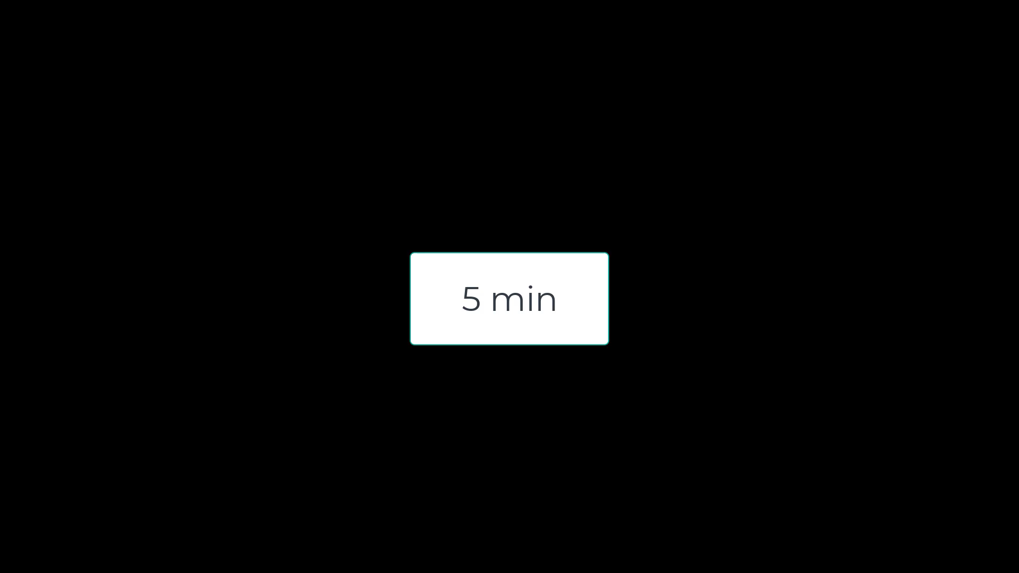
Example & Activity — Campus Parking Permit System
We have completed the User–Permit part together. Now, please design the rest of the UML diagram by adding:
Permit–Payment (mandatory relationship, action label ‘requires’).
SecurityOfficer–Permit (dependency with revoke action).
Permit–VehicleInfo (composition, black diamond). Remember to use rectangles for classes, ovals for methods, and mark multiplicity (0..1, 1, etc.).”

Slide 25
Example & Activity — Campus Parking Permit System
Complete the UML Relationships
Permit–Payment (mandatory)
Permit (1) ── (1) Payment
Action: “requires”
Explain: every permit must have exactly one payment when created.
SecurityOfficer–Permit (dependency)
Dashed arrow SecurityOfficer ──> Permit
Action: “revoke()”
Explain: dependency, because SecurityOfficer needs Permit to perform revoke.

Slide 26
Composition (Strong Link)
Each Permit is tied to exactly one Vehicle (by plate number).
If the permit is deleted, the vehicle link also disappears from the permit system.
UML: Permit ♦─1..1 Vehicle
Permit <<abstract>>
Permit–VehicleInfo (composition)
Black diamond at Permit side.
Multiplicity: 1 Permit → 1 VehicleInfo
Explain: if Permit is deleted, VehicleInfo is deleted too.
VehicleInfo
+id
(1, 1)
+zone
(1, 1)
plate
+plate
make
+status
+semester

Slide 27
Composition (Strong Link)
Composition (black diamond at Permit side) → means a VehicleInfo cannot exist without its Permit. If the Permit is deleted, the VehicleInfo tied to it is also deleted.
Permit <<abstract>>
Multiplicity (1,1) → each Permit is tied to exactly one VehicleInfo, and each VehicleInfo belongs to exactly one Permit.
VehicleInfo
+id
(1, 1)
+zone
(1, 1)
plate
+plate
make
+status
+semester

Slide 28
Attributes:
Permit has fields like id, zone, plate, status, semester.
VehicleInfo has plate and make.
Permit <<abstract>>
VehicleInfo
+id
(1, 1)
+zone
(1, 1)
plate
+plate
make
+status
+semester

Slide 29
Example & Activity — Campus Parking Permit System
Permit (1) ── (1) Payment → Every permit needs exactly one payment at the time of issue.
SecurityOfficer ──> Permit → A Security Officer can revoke (dependency arrow).
Permit ── VehicleInfo (composition) → Permit owns vehicle info (plate, make). If permit deleted → vehicle info deleted.

Slide 30
Example & Activity — Campus Parking Permit System
5. Optional vs Mandatory
Optional: Permit for a User (not all users will request one).
Mandatory: Payment for Permit (no free permits).

Slide 31
Example & Activity — Campus Parking Permit System
6. Action Verbs
Relationships should use verbs:
User requests Permit.
Permit requires Payment.
Security Officer revokes Permit.
ParkingDB stores Permits.

Slide 32
Example & Activity — Campus Parking Permit System
7. Include / Exclude (use cases)
100 User logs in → include validate credentials.
200 Request permit → include take payment, save record.
210 Prevent >1 active permit → exclude if user already has permit.
300 Security revokes permit → include change status to inactive.
400 Admin lists permits → include filter by zone, semester.

Slide 33
Example & Activity — Campus Parking Permit System
Simple Story Example
Ali (Student) logs in and applies for a parking permit.
His User account (Student) is linked to Permit #123.
Permit #123 is tied to his Vehicle (plate ABC-123).
If the permit is revoked, the vehicle–permit link is gone too.

Slide 34
Example & Activity — Campus Parking Permit System
8. Dependency
Dependency means one class needs another to do something.
Example: SecurityOfficer → Permit (dependency: revoke()). Without Permit, revoke() makes no sense.

Slide 35
Example & Activity — Campus Parking Permit System
9. Composition vs Aggregation
Permit – VehicleInfo = Composition (solid diamond).
Permit has VehicleInfo (plate, make) — if permit deleted, vehicle info goes too.
Reason: Vehicle info cannot exist separately from Permit. (When permit deleted, vehicle info goes away too.)

Slide 36
Example & Activity — Event Ticketing Lite
Mini case
Users create Events (title, date). Users can book Tickets. One user can book many tickets; an event has many tickets → many-to-many via Booking association class (bookingId, qty, timestamp). An event may have a parent event (series) → reflexive association. Tickets can be PENDING/CONFIRMED/CANCELLED (simple state).
Think of Candidate Classes, Key Relationships, Sample Backlogs IDs,

Slide 37
Example & Activity — Event Ticketing Lite
Candidate classes
User (id, name, email)
Event (id, title, date, parentEvent?) (reflexive)
Ticket (id, price, state)
Booking (association class between User and Event): qty, timestamp
Store for file I/O

Slide 38
Example & Activity — Event Ticketing Lite
Key relationships
User M ── M Event through Booking (association class)
Event 0, 1 ── 0, M Event (reflexive “is part of series”)
Booking 1 ── M Ticket (composition: tickets belong to that booking)

Slide 39
Example & Activity — Event Ticketing Lite
Sample backlog IDs
100 Register/login user
200 Create event
300 Book tickets / include check availability / include save
310 Cancel booking / extend show refund notice
400 List events and my bookings

Slide 40
Example & Activity — Event Ticketing Lite
Activity:
Association class practice: Draw Booking between User and Event with attributes; add multiplicities on both sides.
Reflexive association: Add Event → Event “parentOf”; mark multiplicity 0..1 to 0..M.
State note: Add a note listing Ticket.state ∈ {PENDING, CONFIRMED, CANCELLED} and link it to cancellation use case as an extend.

Slide 41

Happy Learning and Bright Futures Ahead! Dr. Farshid Keivanian Stay Connected: linkedin.com/in/farshid-keivanian github.com/FarshidKeivanian
Education is the most powerful weapon you can use to change the world. — Nelson Mandela

